Slide 1
Challenge Name
Team Name

Slide 2
The Theme of Your
Design Competition

Slide 3
Important Topic 🤯
You’re presenting these slides in front of people
Try not to use so many words on screen!
Instead, limit yourself to as little words as possible on the slide
Focus on speaking the most and practicing public speech
You can use speaker notes below to hide all your speaking words from the audience

Slide 4
Displaying Content
Show off those trade studies and how you came to your decisions!
When talking about research, talking in depth but still at a simple level can bring the audience in
This is good practice and a good way to get effective feedback from your peers!
It is also a good test to see if you’re at a good place or if there is still work to be done (don’t be scared)

Slide 5
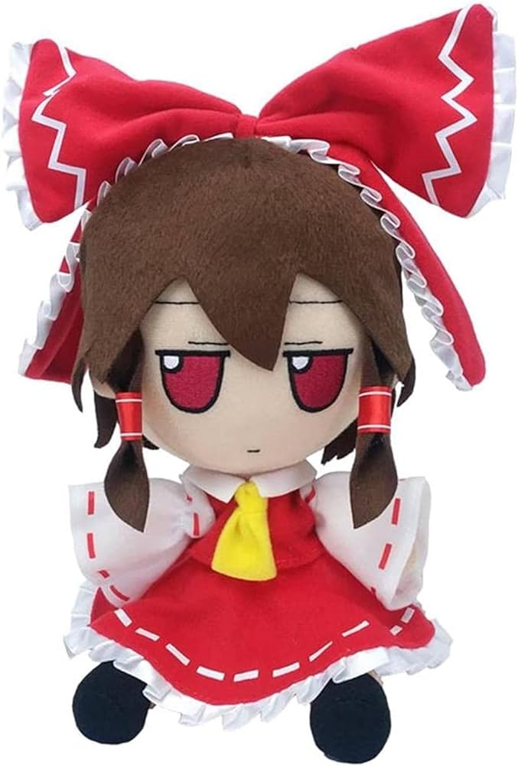

Images
IMAGES SHOULD LOOK LIKE ONE OF THE FOLLOWING
Non transparent images should have a blue outline
Transparent ones do not require an outline

Slide 6
Any Questions?

Slide 7
Thermals, Mechanisms, Structures (TMS)

Slide 8
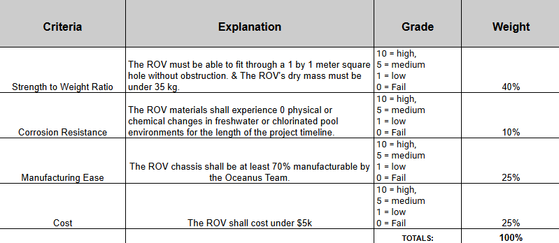
Material Justification

Slide 9
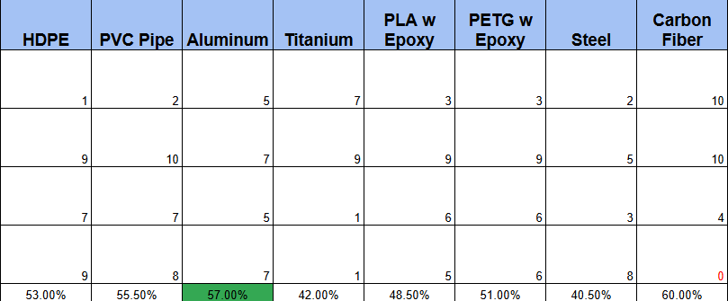
Material Selection

Slide 10
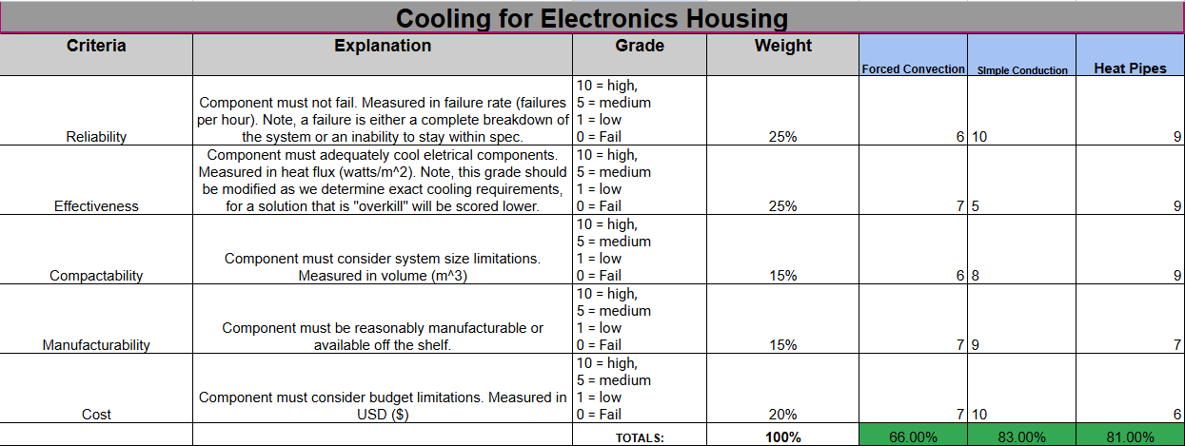
Cooling

Slide 11
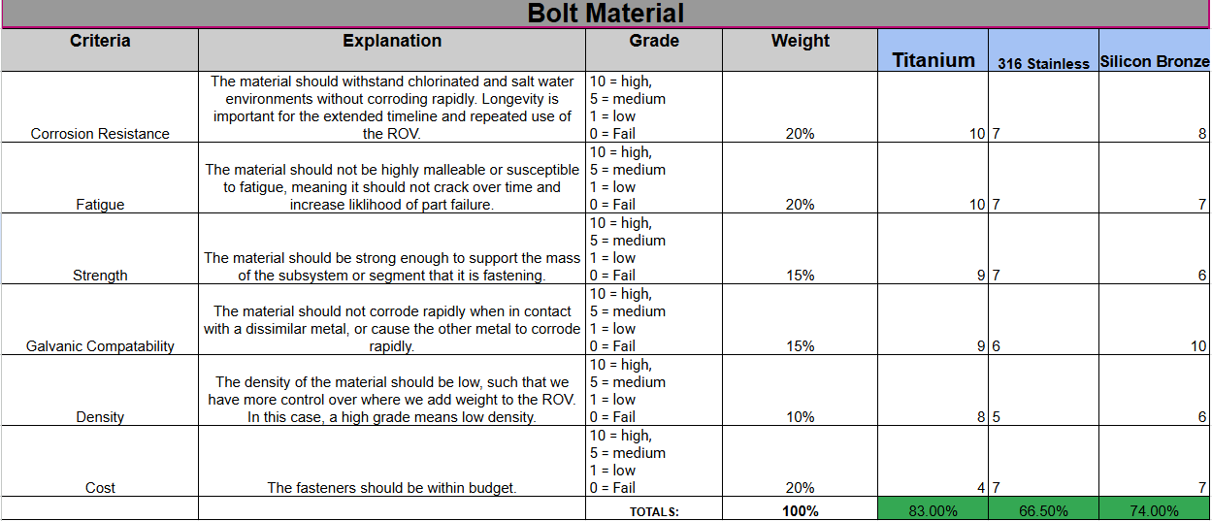
Bolt Material

Slide 12
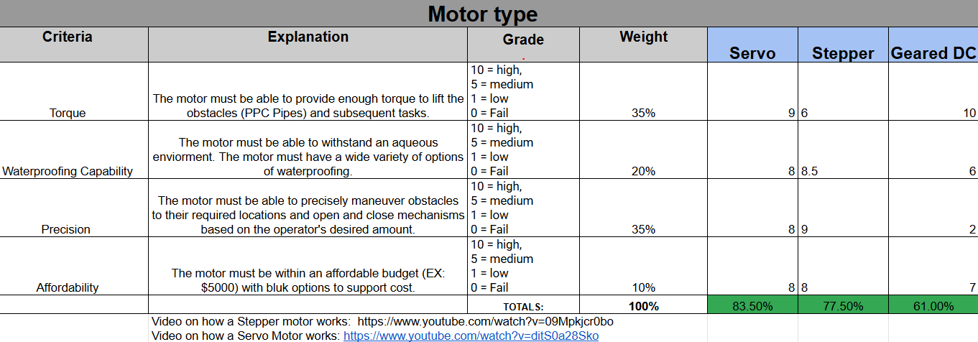
Motor Selection

Slide 13
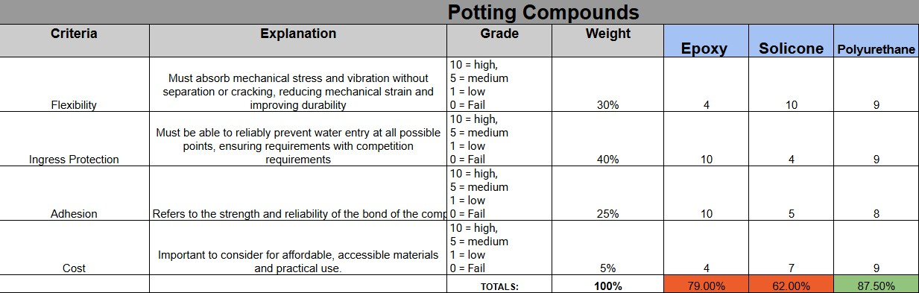
Potting Compounds

Slide 14
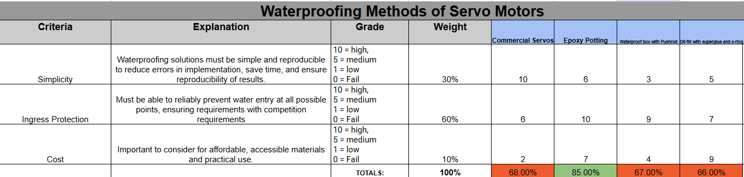
Waterproofing Servo Motors

Slide 15
Guidance Navigation and Control (GNC)

Slide 16
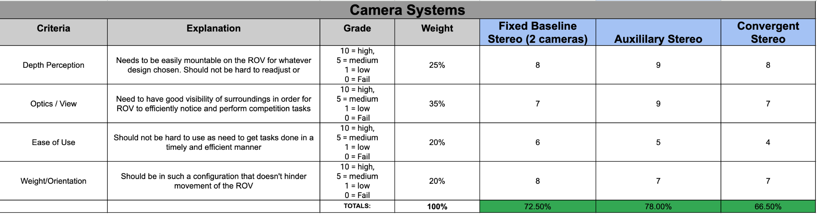
Camera Systems

Slide 17
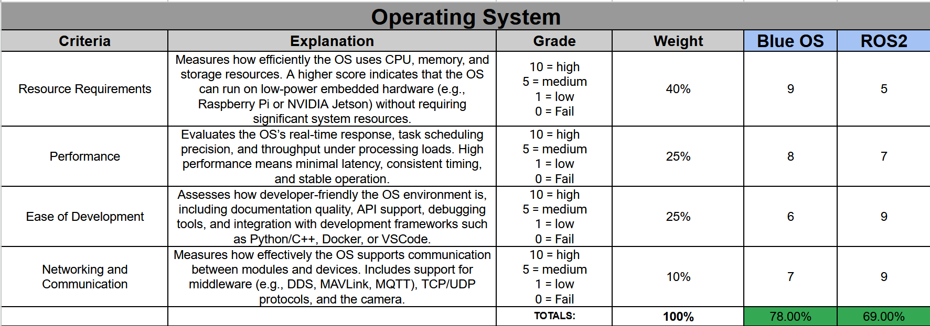
Operating Systems
Notes:
Resource Requirements
Blue OS: 9
Designed to be lean (RTOS-like footprint, minimal services), so it runs comfortably on low-power MCUs or small SBCs with tight RAM/flash budgets.
Predictable memory usage (static allocation/common single-process model) and limited background daemons keep CPU load and storage needs very low.
ROS 2: 5
Runs atop Linux with multiple services (DDS, discovery, logging, parameter server equivalents, daemonized tools); higher baseline CPU/RAM and storage.
Containerization and language runtimes (C++/Python) plus DDS middleware add overhead that can be significant on Raspberry Pi-class hardware.
Performance
Blue OS: 8
Preemptive, deterministic scheduling typical of embedded/RTOS designs yields low and consistent latency for control loops and IO.
Minimal user-space/service layers between drivers and application reduce jitter under load.
ROS 2: 7
With PREEMPT-RT kernels and tuned DDS (Cyclone/FastDDS QoS), ROS 2 can meet many soft real-time needs, but extra middleware layers and message serialization introduce more latency/jitter than a slim RTOS stack.
Throughput is strong, but timing consistency under heavy pub/sub traffic can require careful QoS and executor tuning.
Ease of Development
Blue OS: 6
Simple APIs and build system, but a smaller ecosystem; fewer ready-made packages, fewer high-level tools, and more DIY for drivers/integration.
Debugging is closer to bare-metal/embedded (JTAG, serial logs) with less out-of-the-box visualization and recording.
ROS 2: 9
Large community and package ecosystem; ready modules for navigation, perception, drivers, and simulation
Mature tooling (rviz, rqt, rosbag, tf, launch files), multiple client libraries (rclcpp/rclpy), and abundant docs/tutorials make iteration and collaboration fast.
Networking & Communication
Blue OS: 7
Solid support for core protocols (TCP/UDP, MAVLink/MQTT available via libraries) and straightforward point-to-point comms.
Discovery, QoS controls, and multi-robot coordination usually require additional libraries or custom work.
ROS 2: 9
DDS under the hood provides discovery, QoS (reliability, durability, deadlines), and scalable pub/sub out of the box—excellent for multi-node and multi-robot systems.
Rich message types, standard interfaces (sensor_msgs, nav_msgs), and widespread camera/driver support make interop and distributed systems easier.

Slide 18
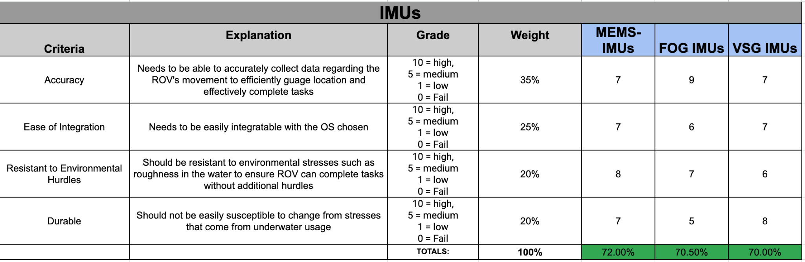
IMUs

Slide 19
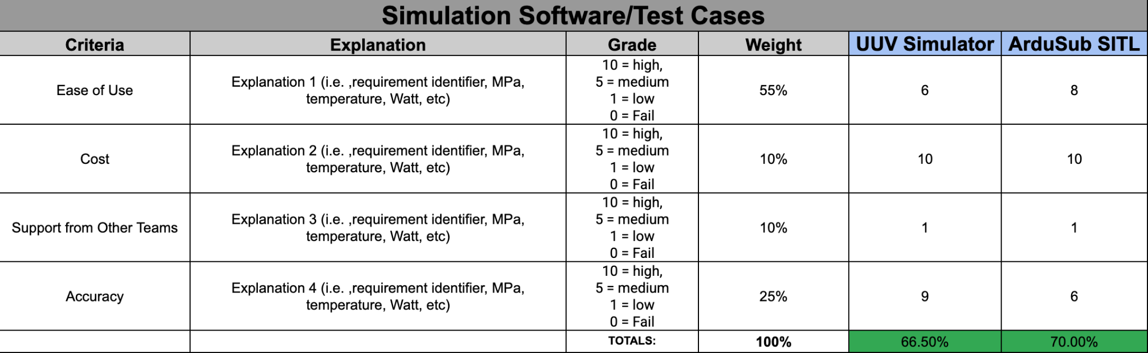
Simulation Software

Slide 20
Single Board Computers

Slide 21
Computation and Communications (C&C)

Slide 22
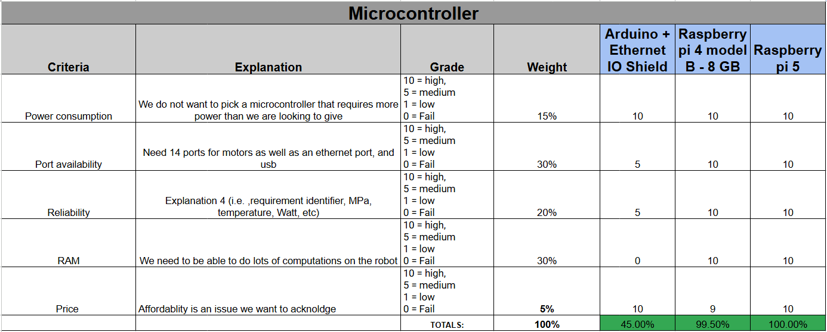
Microcontroller
Notes:
It’s over Vecna, we are the Stranger Things.

Slide 23
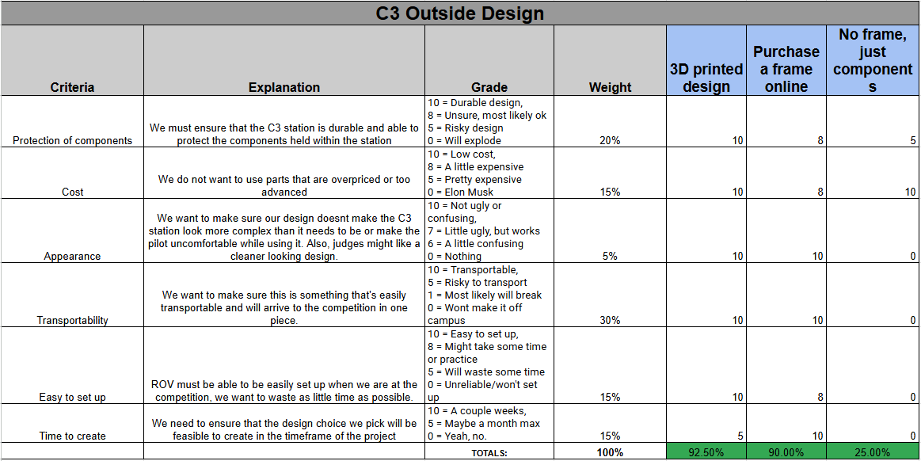
C3 Station Outside Design

Slide 24
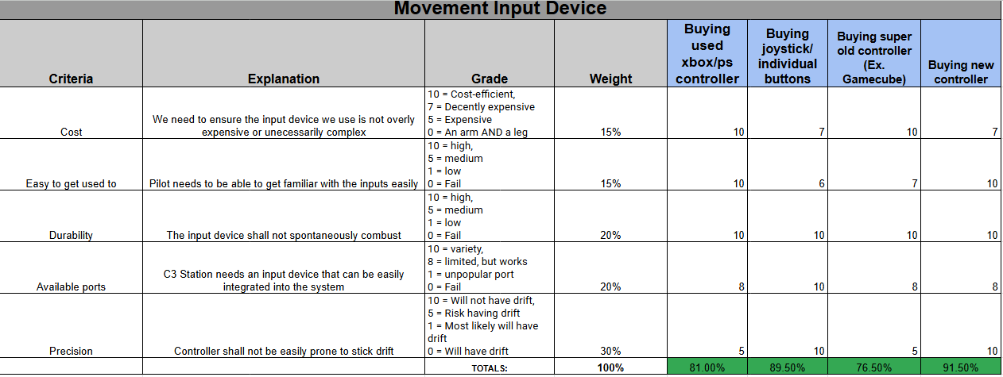
C3 Station Movement Input Device

Slide 25
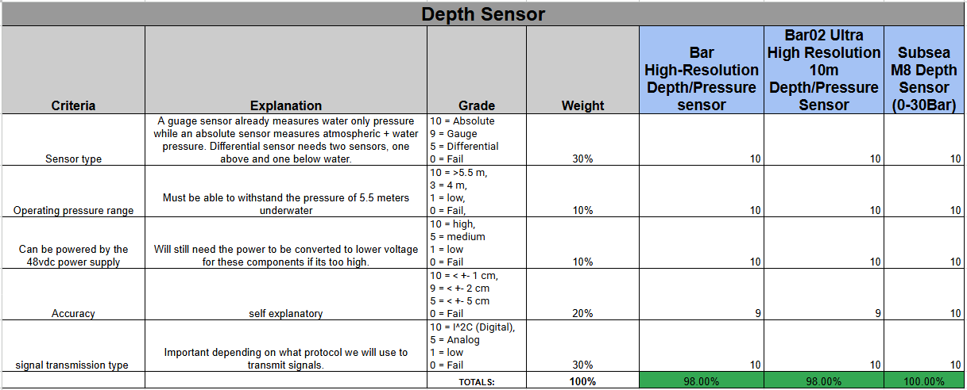
Depth Sensor

Slide 26
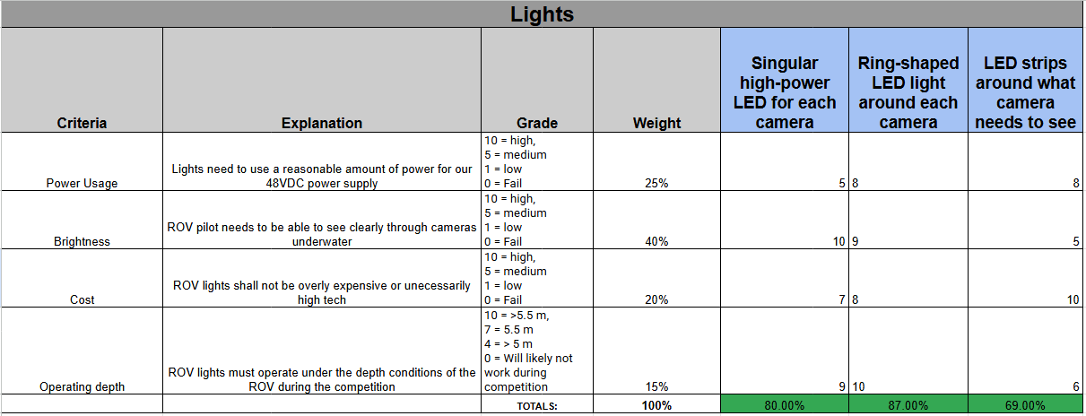
Lights

Slide 27
Fluids & Propulsion (F&P)

Slide 28
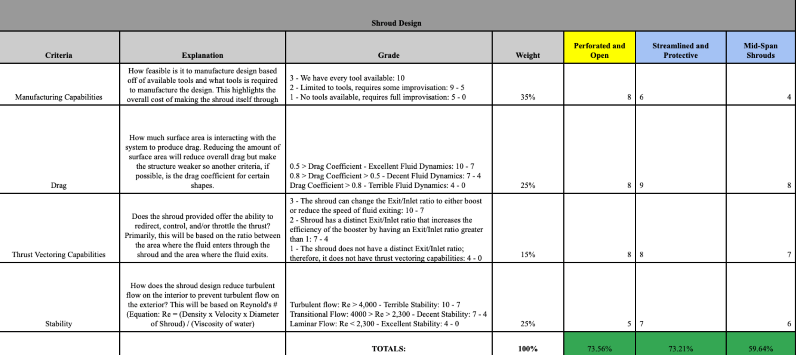
Thruster Guard Shroud Design

Slide 29
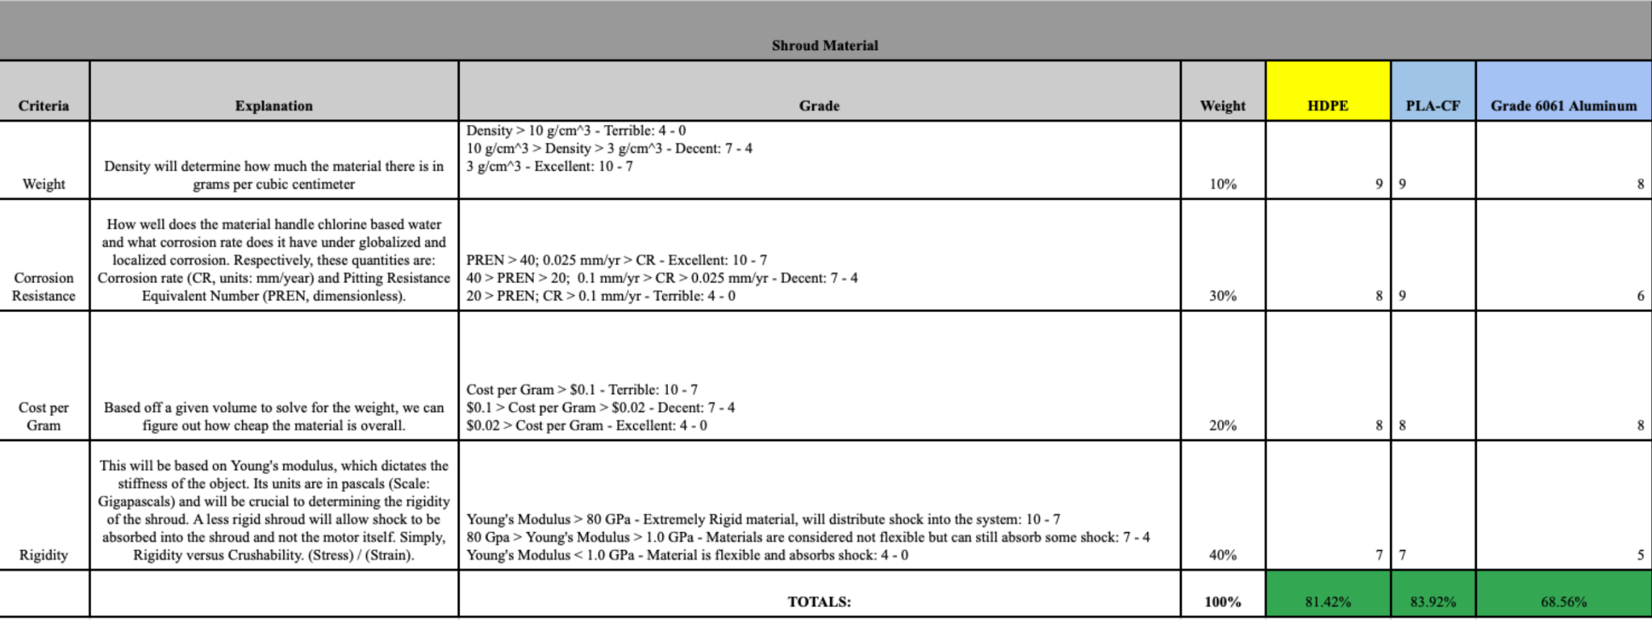
Thruster Guard Shroud Materials

Slide 30
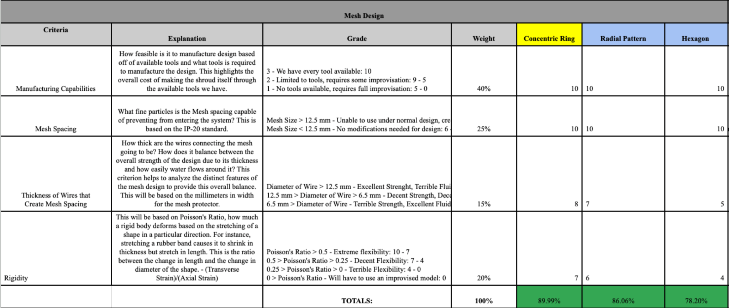
Thruster Guard Mesh Design

Slide 31
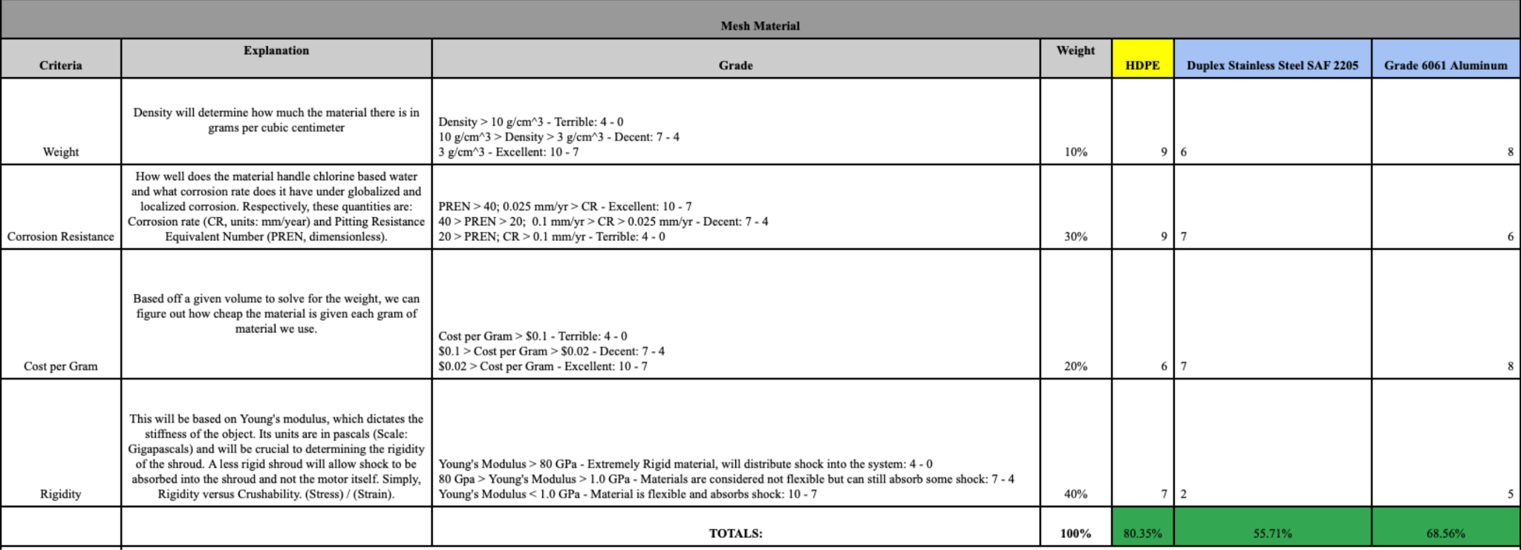
Thruster Guard Mesh Materials

Slide 32
Summary of Thruster Guard Shroud & Mesh
Trade Study Considerations | Chosen Research | Reason For Choosing Research
Thruster Guard Shroud (TGS) Design | Perforated and Open | Provides debris protection for propellers while allowing smooth fluid flow around the TGS.
TGS Material | High Density Polyethylene (HDPE) | HDPE TGS offers an ideal balance of rigidity and flexibility, providing structure while absorbing shock.
Thruster Guard Mesh (TGM) Design | Concentric Ring | Each mesh spacing allows uniform flow while blocking finger-sized debris from the propellers.
TGM Material | High Density Polyethylene (HDPE) | Like the TGS, the TGM should use an HDPE base to balance rigidity and flexibility.

Slide 33
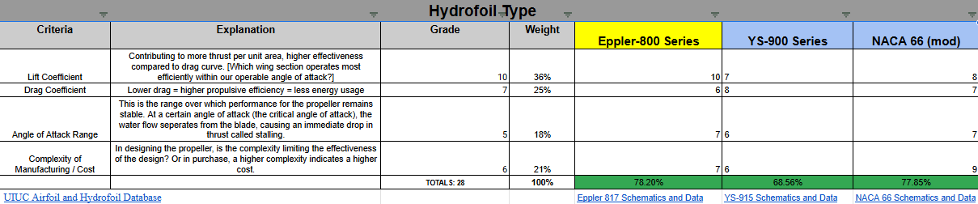
Hydrofoil Type
Notes:
*Re was calculated using the maximum expected velocity and maximum expected length from the leading to the trailing edge of the hydrofoil
*The gain in lift coefficient for the Eppler 800 series outweighed the complexity of manufacturing for the NACA 66 mod
*

Slide 34



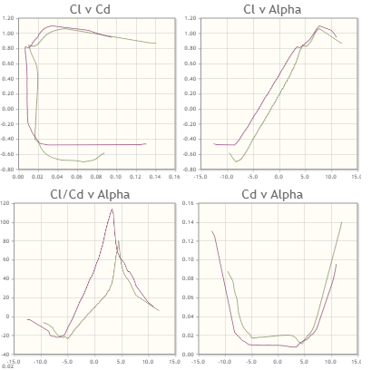
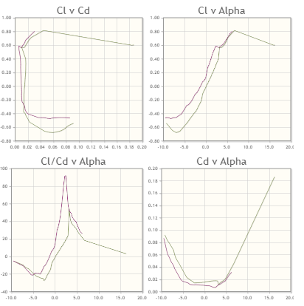
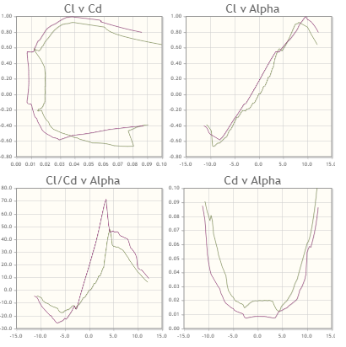
Hydrofoil Schematics
Eppler 817
YS-915
NACA 66
Notes:
It is evident that the Eppler 817 hydrofoil has a significantly higher coefficient of lift curve compared to the other two choices.This lift gain outweighs the complexity of manufacturing for the NACA 66 hydrofoil.
The red curve contributes to a Re of 500,000 while the beige curve contributes to one of 200,000

Slide 35
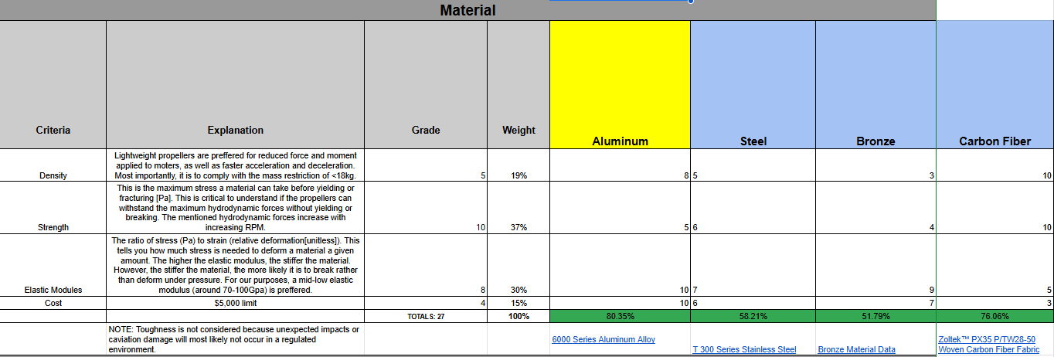
Propeller Material
Notes:
The amount of pressure withstood at the maximum depth of 10 meters does not justify using a propeller created out of carbon fiber. The difficulties of dealing with epoxy reinforcement and manufacturing the carbon fiber in the first place is undesirable.
On the other hand, the aluminum propellers would require us to cast the metal, which might not be an available option to us, or to weld parts together. In that case, we can resort to a fiberglass epoxy propeller.
*NOTE: FEA analysis will be done on upcoming designs in order to further justify material choices.

Slide 36
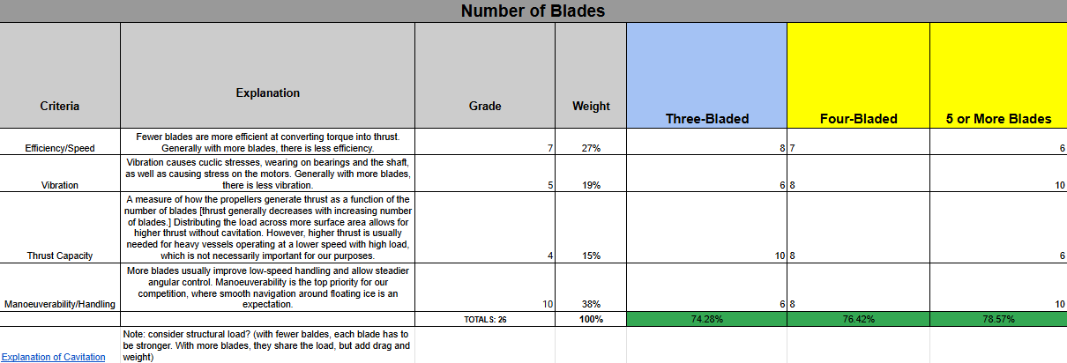
Propeller Blades
Notes:
*NOTE: Number of blades cannot be chosen until the shaft power provided by the motors is available

Slide 37
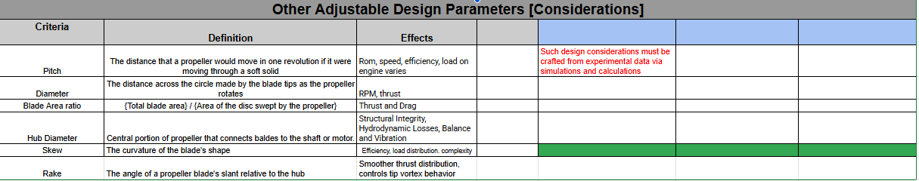
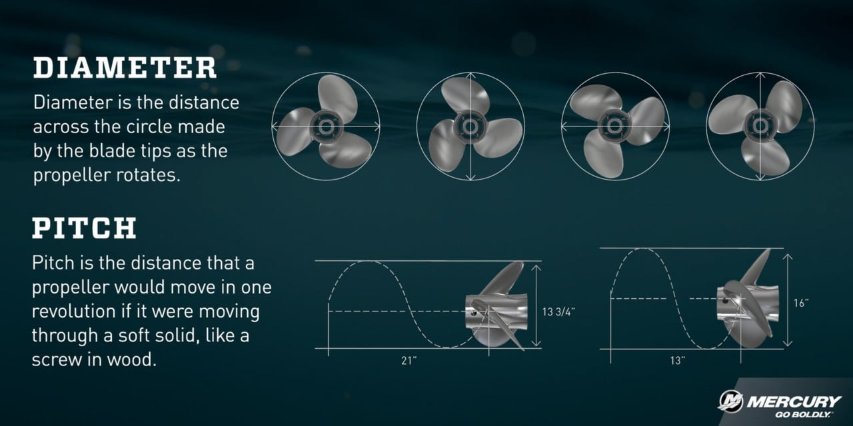
Design Parameters for Consideration

Slide 38
Electrical Power Systems (EPS)

Slide 39
Power Supply
Criteria | Explanation | Grade | Weight | 12 VDC | 48 VDC
Tether Cable Size & Weight | Smaller gauge cables can be used with higher voltage, improving maneuverability and reducing drag. | 3 = High 2 = Medium 1 = Low 0 = Fail | 15% | 2 | 3
Power Transmission Efficiency | Lower current at higher voltage reduces I²R losses in the tether cable. This improves efficiency and reduces power loss. |  | 20% | 1 | 3
Thruster Power Delivery | Voltage vs. required thruster input voltage & startup current - especially important if thrusters draw pulsed or high currents |  | 15% | 1 | 3
Voltage Regulation / Stability | Need for DC-DC converters and complexity of power distribution at the ROV end. |  | 10% | 3 | 2
Safety / Standards Compliance | Lower voltages are safer for human handling and reduce underwater electrical hazard risk. |  | 10% | 3 | 2
Component Availability / Cost | Availability of compatible power electronics and end-use subsystems (e.g., sensors, controllers) and their cost. |  | 5% | 3 | 2
Heat Dissipation (Converters) | High current results in higher local power dissipation. Lower heat is easier to manage in a sealed or underwater enclosure. |  | 10% | 1 | 3
Electromagnetic Interference (EMI) | Higher voltages may increase EMI, affecting sensors or communication systems. |  | 5% | 3 | 2
Future Scalability / Growth | Ability to support future upgrades with higher power demand without major redesign. |  | 10% | 1 | 3
 |  |  | 100% | 58.33% | 90.00%

Slide 40
Connectors
Criteria | Explanation | Grade | Weight | SubConn Micro Circular | Blue Robotics WLPs | Cable Glands (Nickel-Plated Brass)
Waterproof Reliability | Most critical criteria; failure is catastrophic for the competition. | 5 = High 3 = Medium 1 = Low 0 = Fail | 22% | 5 | 5 | 4
Mechanical Durability | Must withstand the harsh physical environment (pressure, impacts) to prevent seal failure. |  | 16% | 5 | 4 | 4
Safety & Standards | Ensures electrical safety and adherence to industry standards for reliability. |  | 16% | 5 | 4 | 3
Current/Voltage Capacity | A fundamental design requirement to meet the system's electrical load. |  | 12% | 4 | 4 | 3
Maintenance / Reusability | Lowers long-term operational cost and complexity for repairs and upgrades. |  | 12% | 5 | 4 | 4
Ease of Use | A secondary convenience for us during handling and field operations. |  | 8% | 5 | 3 | 4
Ease of Integration | A one-time effort for the initial build; less impact on long-term operation. |  | 8% | 4 | 5 | 3
Cost & Availability | Lowest priority; performance is valued more than initial cost (this section is the most iffy because idk how much of our budget is going to be used by other things) |  | 6% | 2 | 3 | 5
 |  |  | 100% | 92.4% | 83.2% | 74%

Slide 41
Tether Type/Size
Category | Weight | Criteria | High/Low | Twisted Pair / Electrical Tether |  | Fibre Optic
Cost | 30% | Cost in USD per meter | FALSE | 260 | 30.00% | 279 | 0.00%
Data Transmission Rate/Bandwidth | 50% | In Kbps | TRUE | 100 | 0.00% | 800000000 | 50.00%
Strength/Durability | 20% | Measured in tensile strength in newtons | TRUE | 1520 | 20.00% | 1500 | 19.74%
Totals |  |  |  |  | 50.00% |  | 69.74%

Slide 42
Onboard Architecture
Criteria | Explanation | Grade | Weight | Distributed Local DC-DC Conversion | Dual-Voltage Bus | Single-Bus Centralized DC
Electrical Efficiency | Reduces resistive losses and optimizes power transfer for long tether systems. | 5 = High 3 = Medium 1 = Low 0 = Fail | 18% | 5 | 4 | 3
Safety & Fault Tolerance | Ensures system protection from faults and protects divers and electronics. |  | 18% | 5 | 4 | 3
Modularity / Scalability | Allows expansion, subsystem replacement, or upgrades easily. |  | 14% | 5 | 4 | 2
Maintenance / Serviceability | Simplifies troubleshooting and long-term upkeep. |  | 12% | 3 | 3 | 4
Weight & Space Efficiency | Reduces housing footprint and helps achieve neutral buoyancy. |  | 10% | 3 | 3 | 4
Cost & Complexity | Balances affordability and simplicity of implementation. |  | 10% | 2 | 3 | 5
Ease of Integration | Simplifies wiring, layout, and assembly during manufacturing. |  | 10% | 3 | 4 | 5
Standards / Reliability | Adheres to marine electrical standards and proven reliability. |  | 8% | 5 | 4 | 3
 |  |  | 100% | 81.2% | 73.6% | 69.6%

Slide 43
Wire Color Scheme
Category | Weight | Criteria | High/Low | US IEC 60446 AC/DC Codes |  | ABYC E-11
Simplicity | 20% | Number of required colors/rules | FALSE | 6 | 10.77% | 13 | 0.00%
Ease of Debugging | 60% | Difficult to measure, based on number of useful colors/subsystems | TRUE | 6 | 40.00% | 9 | 60.00%
Standardized Colors | 20% | Use of the coloring scheme, popularity in ROV industry by percent | TRUE | 99 | 20.00% | 90 | 18.18%
Totals |  |  |  |  | 70.77% |  | 78.18%

